Slide 1

Recurrent NEURAL NETWORKS
FARZEEN ASHFAQ

Slide 2
Acknowledgement
Dr. Saman Hina (Associate Professor , NEDUET Karachi)
Dr. Saad (Assistant Professor)

Slide 3

Agenda
What is a Neural Network?
Popular Neural Networks
Need for Recurrent Neural Networks
What is a Recurrent Neural Network?
How does an RNN works ?
Long Short Term Memory (LSTM)

Slide 4

MOTIVATION
Do you know how Google’s autocomplete feature predicts the rest of the words a user is typing?

Slide 5
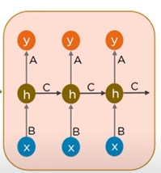



How does it predicts?
Angeles

Slide 6
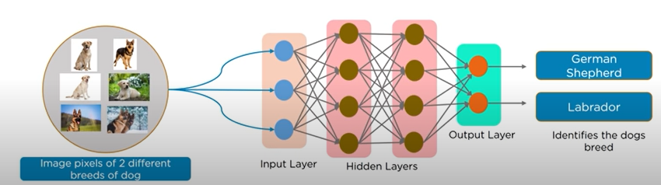
Neural networks
Neural Networks in deep learning, consists of different layers connected to each other and work on the structure and functions of a human brain, it learns from huge volumes of data and uses complex algorithms to train a neural network.

Slide 7
Popular Neural Networks
Feed Forward Neural Network | Used in general Regression and Classification problems
Convolution Neural Network | Used for Image Recognition
Deep Neural Network | Used for Acoustic Modeling
Deep Belief Network | Used for Cancer Detection
Recurrent Neural Network | Used for Speech Recognition

Slide 8
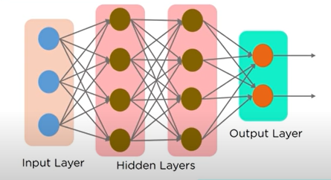
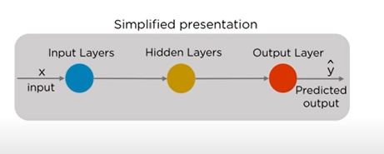
Feed forward neural network
In Feed Forward Neural Networks the information flows only in one direction , from the input nodes, through the hidden layer (if any) and to the output nodes. There are no cycles or loops in the network.

Slide 9
Why Recurrent neural network
1) Cannot handle sequential data
2) considers only the current input
3) cannot memorize previous inputs

Slide 10

What is sequence learning
Sequence learning is the study of machine learning algorithms designed for sequential data
Language model is one of the most interesting topics that use sequence labeling.
Language Translation
1. Understand the meaning of each word, and the relationship between words
2. Input: one sentence in German input = "Ich will stark Steuern senken"
3. Output: one sentence in Englishoutput = "I want to cut taxes bigly" (big league?)

Slide 11
Getting targets when modeling sequences
When applying machine learning to sequences, we often want to turn an input sequence into an output sequence that lives in a different domain.
– E. g. turn a sequence of sound pressures into a sequence of word identities.

Slide 12
Getting targets when modeling sequences
When there is no separate target sequence, we can get a teaching signal by trying to predict the next term in the input sequence.
– The target output sequence is the input sequence with an advance of 1 step.
– This seems much more natural than trying to predict one pixel in an image from the other pixels, or one patch of an image from the rest of the image.
– For temporal sequences there is a natural order for the predictions.

Slide 13
Getting targets when modeling sequences
Predicting the next term in a sequence blurs the distinction between supervised and unsupervised learning.
– It uses methods designed for supervised learning, but it doesn’t require a separate teaching signal.

Slide 14
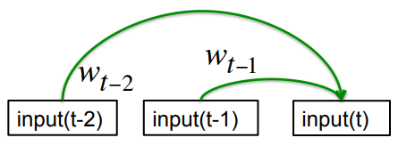
Memoryless models for sequences
Auto-regressive models
Predict the next term in a sequence from a fixed number of previous terms using “delay taps”.

Slide 15
Beyond memoryless models
If we give our generative model some hidden state, and if we give this hidden state its own internal dynamics, we get a much more interesting kind of model.
– It can store information in its hidden state for a long time.
– If the dynamics is noisy and the way it generates outputs from its hidden state is noisy, we can never know its exact hidden state.
– The best we can do is to infer a probability distribution over the space of hidden state vectors.
• This inference is only tractable for two types of hidden state model.

Slide 16
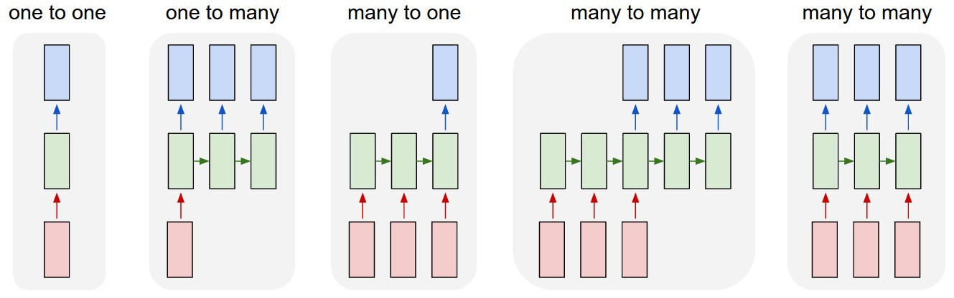
Sequence modelling
Image classification
Image captioning
Sentiment analysis
Machine translation
Video frame-by-frame classification

Slide 17
Recurrent neural networks
RNNs take the previous output or hidden states as inputs
The composite input at time t has some historical information about the happenings at time T< t
RNNs are useful as their intermediate states can store information about past inputs for a time that is not fixed a priori

Slide 18
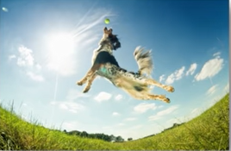

Applications of rnn
IMAGE CAPTIONING
RNN is used to caption an image by
analyzing the activities present in it

Slide 19
Sample feed forward network
y₁
h₁
x₁
t = 1

Slide 20
Sample RNN
y₃
y₂
h₃
h₂
x₃
y₁
t = 3
x₂
h₁
t = 2
x₁
t = 1

Slide 21
Sample RNN
y₃
y₂
h₃
h₂
x₃
y₁
t = 3
x₂
h₁
t = 2
x₁
t = 1

Slide 22
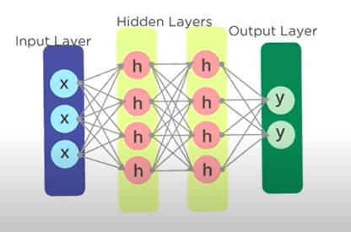
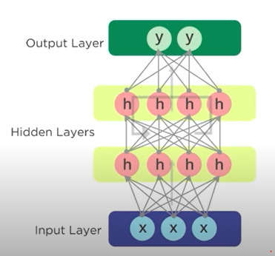
CNN Vs RNN

Slide 23
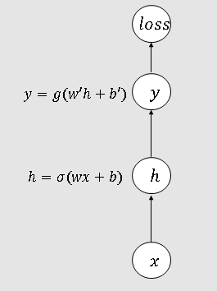
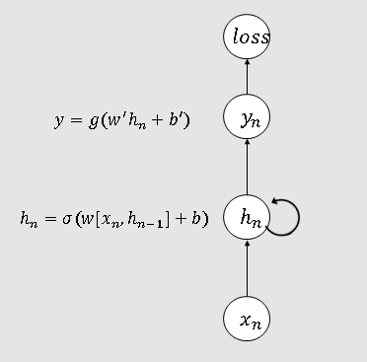
rNN Vs CNN

Slide 24
Rnn basic concept
The network is given one input at a time.
It is combined with the hidden state into a vector
This vector goes through the tanh activation
The output is the new hidden state

Slide 25
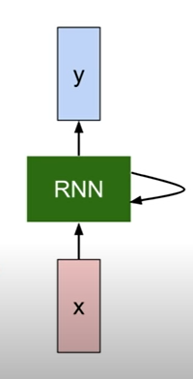
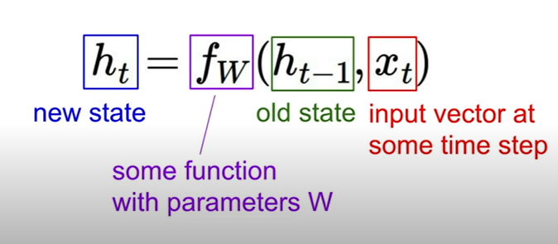
Recurrent neural network
We can process a sequence of vector x by applying a recurrence formula at every time step:

Slide 26
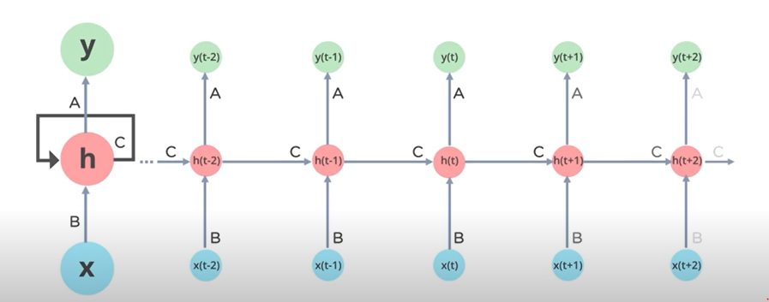

Slide 27
Vanilla recurrent neural network
The state consists of a single “hidden” vector h:
)
)

Slide 28
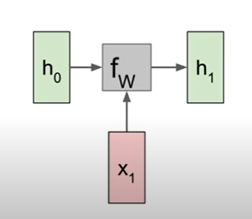
Rnn computational graph

Slide 29
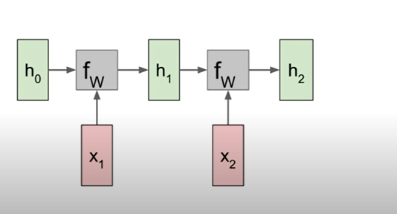
Rnn computational graph

Slide 30
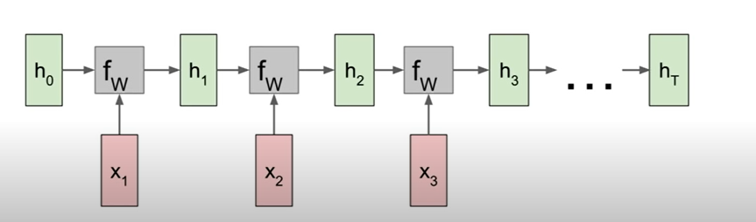
Rnn computational graph

Slide 31
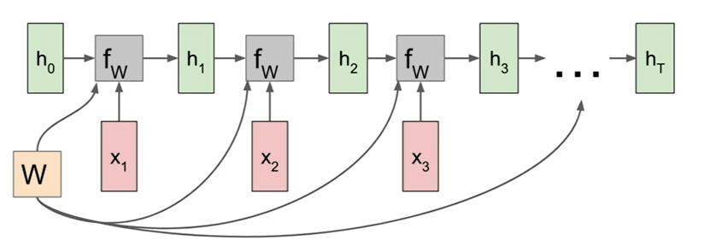
Rnn computational graph

Slide 32
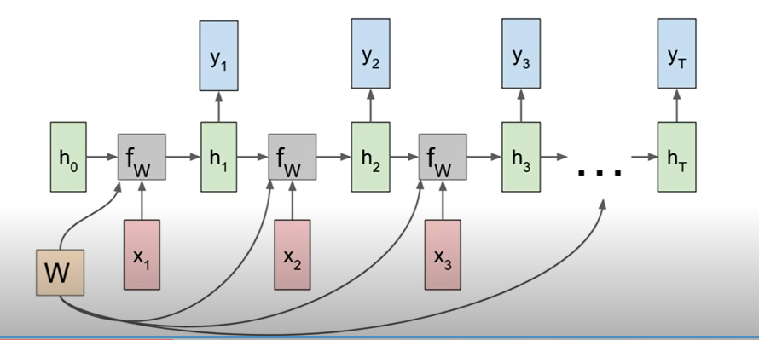
Rnn computational graph : many to many

Slide 33
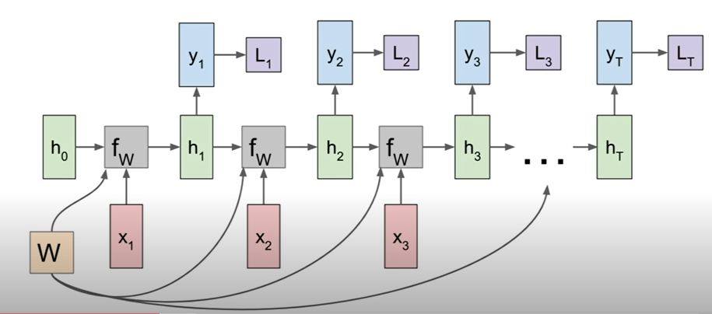
Rnn computational graph : many to many

Slide 34
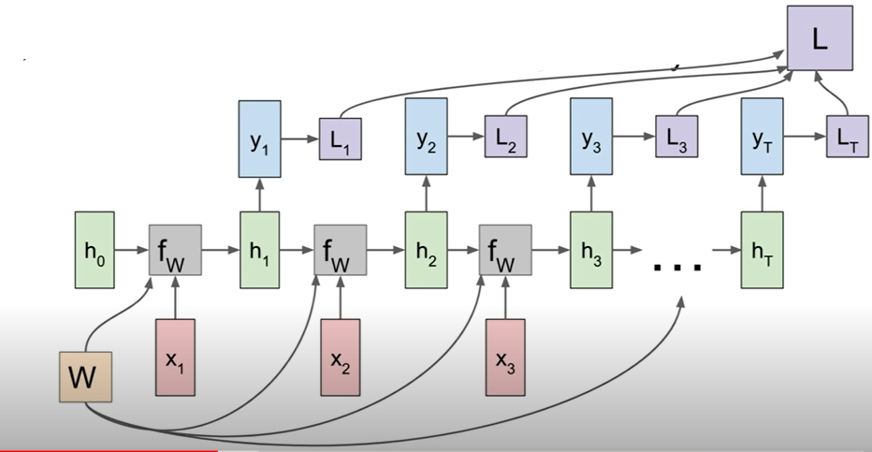
Rnn computational graph : many to many

Slide 35
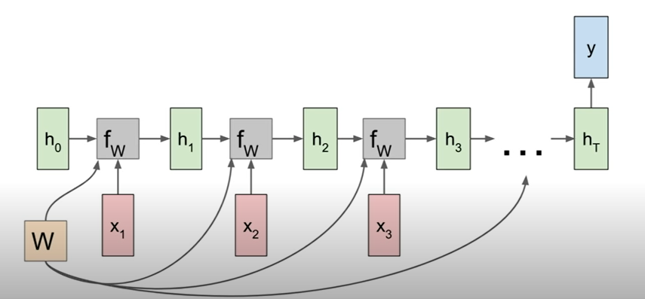
Rnn computational graph : many to one

Slide 36
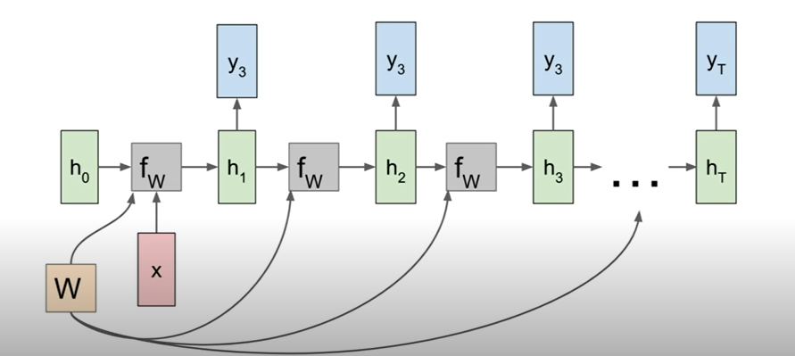
Rnn computational graph : one to many

Slide 37
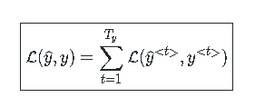
RNN – loss function
In the case of a rnn, the loss function of all time steps is defined based on the loss at every time step as follows:

Slide 38
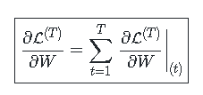
Rnn – backpropagation through time
Backpropagation is done at each point in time. At timestep T, the derivative of the with respect to weight matrix W is expressed as follows:

Slide 39
Vanishing/exploding gradient
The vanishing and exploding gradient phenomena are often encountered in the context of RNNs.
The reason why they happen is that it is difficult to capture long term dependencies because of multiplicative gradient that can be exponentially decreasing/increasing with respect to the number of layers.

Slide 40
Application of rnn: nlp
Given a sequence of words, RNN predicts the probability of next word given the previous ones .
Input/output words are encoded as one -hot vector.
We must provide the RNN all the dictionary of interest (usually, just the alphabet).
In the output layer, we want the green numbers to be high and red numbers to be low

Slide 41
Rnn: types
The 3 most common types of Recurrent Neural Networks are
1. Vanilla RNN
2. LSTM (Long Short-Term Memory)
3. GRU (Gated Recurrent Units)

Slide 42

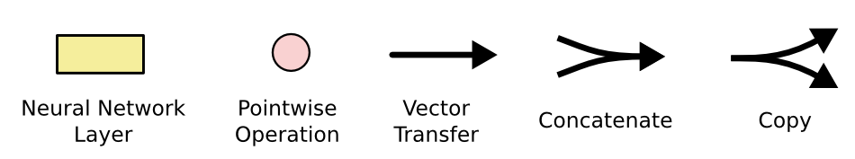
Long short term memory (lstm)
Hidden States
Input Gates
Forget Gates
Output Gates

Slide 43
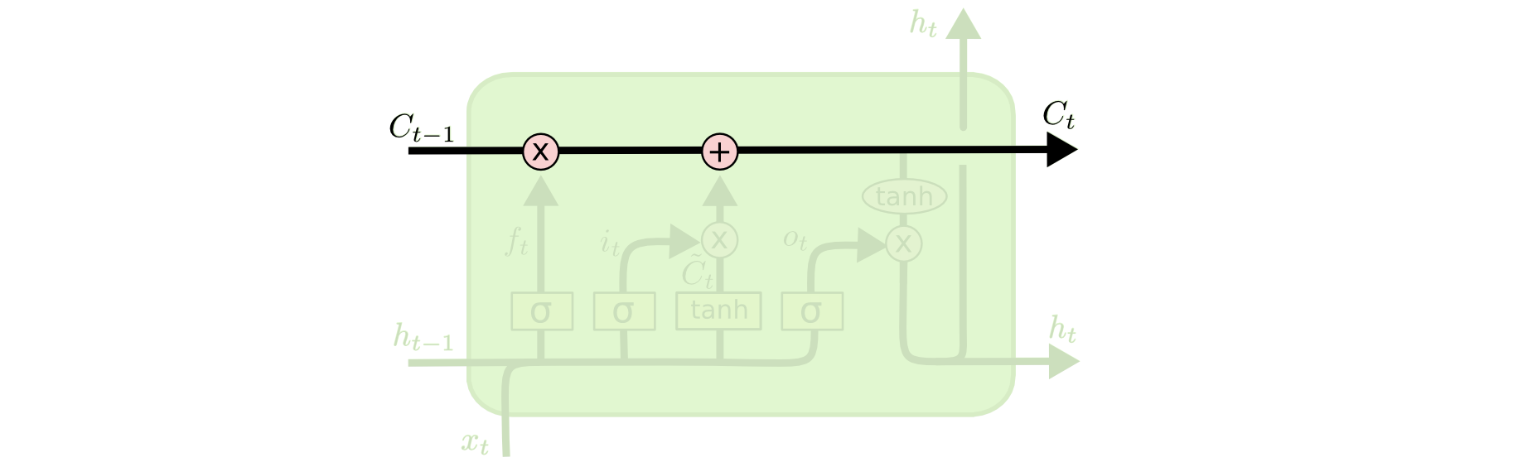
LSTM Cell state
Maintains a vector C_{t} that is the same dimensionality as the hidden state, h_{t}
Information can be added or deleted from this state vector via the forget and input gates.

Slide 44
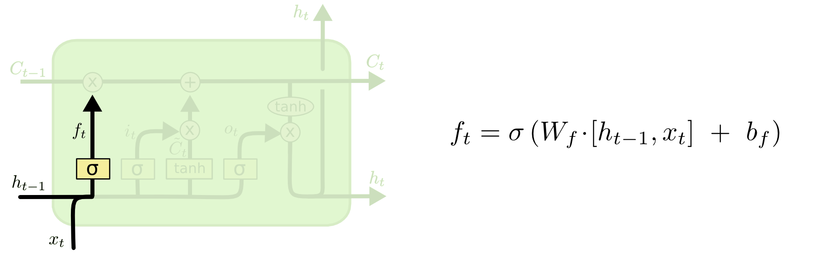
Lstm : Forget gate
Forget gate computes a 0-1 value using a logistic sigmoid output function from the input, x_{t}, and the current hidden state, h_{t}:

Slide 45
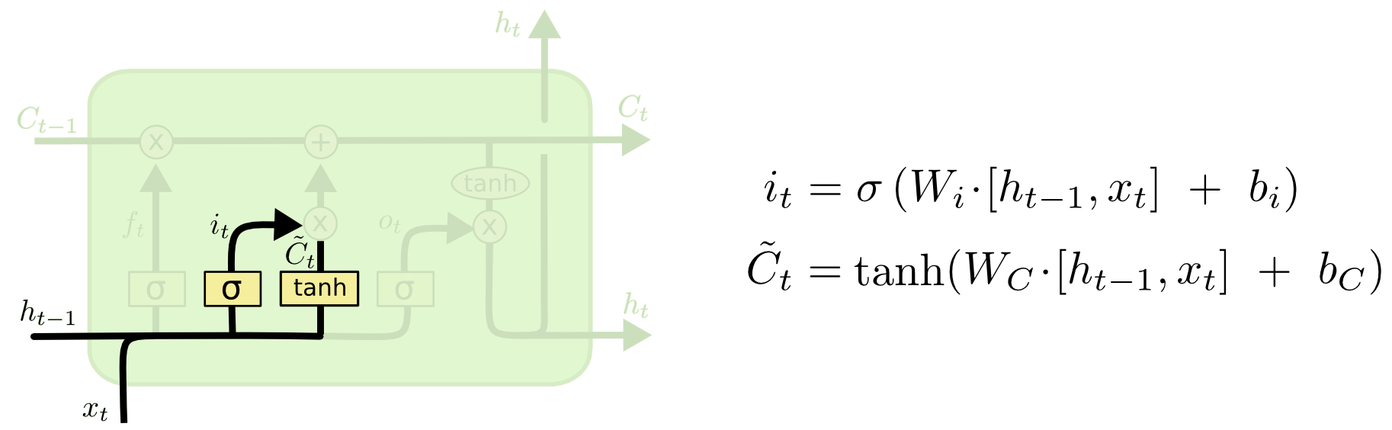
Lstm : input gate
First, determine which entries in the cell state to update by computing 0-1 sigmoid output.
Then determine what amount to add/subtract from these entries

Slide 46
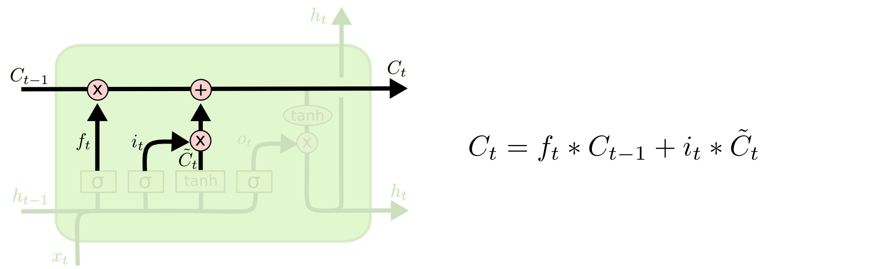
Updating the cell state
Cell state is updated by using component-wise vector multiply to "forget" and vector addition to "input" new information.

Slide 47
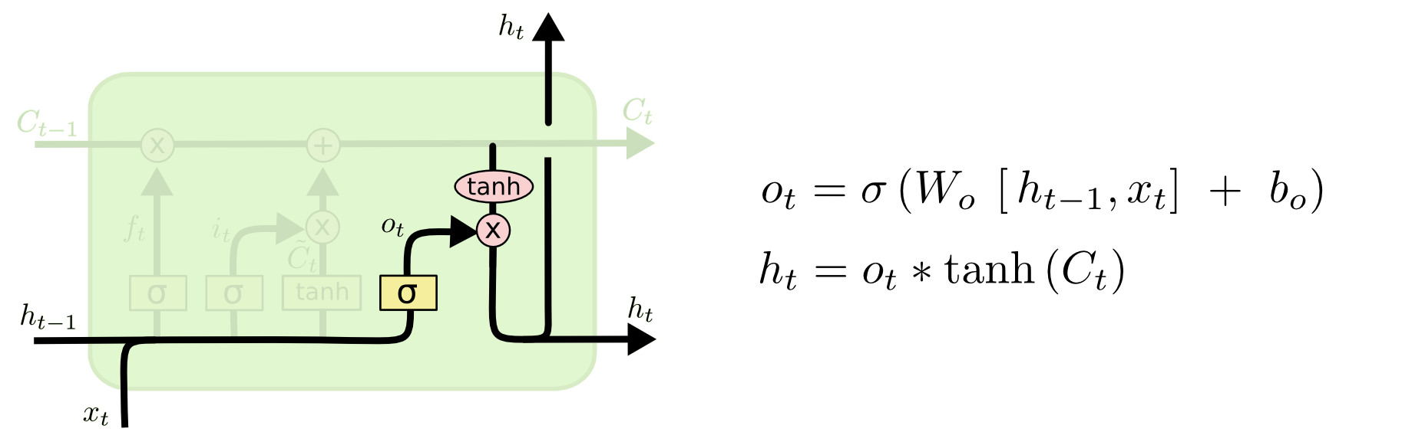
Lstm : output gate
Output gate computes a sigmoid function of the input and current hidden state to determine which elements of the cell state to "output".

Slide 48

Overall network architecture
O_{t}
e.g. a POS tag as a “one hot” vector
Single or multilayer networks can compute LSTM inputs from problem inputs and problem outputs from LSTM outputs
I_{t}
e.g. a word as a “one hot” vector

Slide 49
conclusion
RNN is used for sequence / time-series problem
Gradient vanishing problem limits its effectiveness
LSTM cell to eliminate problem
Practically LSTM works mush better than RNN

